Slide 1
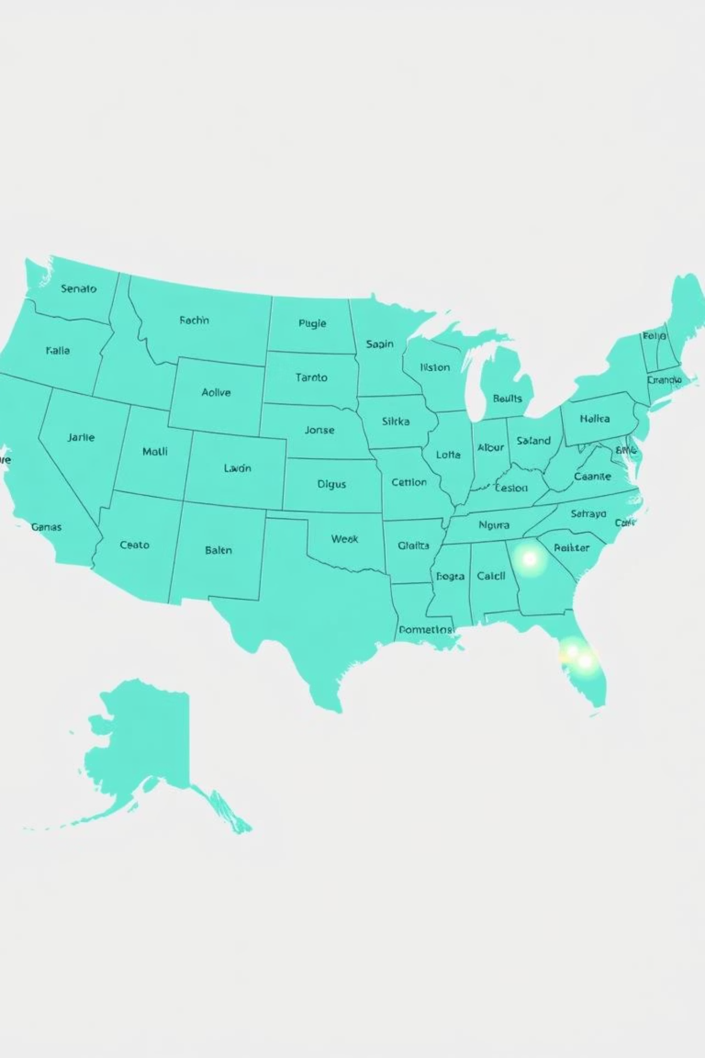
U.S. Emissions Analysis Dashboard
An interactive dashboard commissioned by the EPA to provide a clear, data-driven view of greenhouse gas emissions across the United States. This project aims to identify emission sources, high-contributing regions, and compare emissions relative to population and geographic area.

Slide 2

Project Overview: Key Objectives
Identify Emission Sources
Regional Contributions
Pinpoint where greenhouse gas emissions originate across the U.S.
Determine which regions contribute the most to overall emissions.
Population & Area Comparison
Analyze emissions in relation to population density and geographic size.

Slide 3
Dataset Summary: Comprehensive Emissions Data
The dataset, sourced from Kaggle, contains 3,142 rows and 58 columns of county-level emissions data, including demographic and geographic information. It provides insights into population, employment, energy consumption, and greenhouse gas emissions, enabling trend analysis and understanding the impact of various factors on emissions.
Geographic Identifiers
Demographics & Socioeconomics
State, county, latitude, longitude, climate zone.
Population, employment, housing units, establishments, buildings, area.
Energy Consumption
Emissions Data
Electricity (MWh), Natural Gas (TcF), Fuel & Transportation (gallons, VMT).
GHG emissions in metric tons of CO2 equivalent.

Slide 4

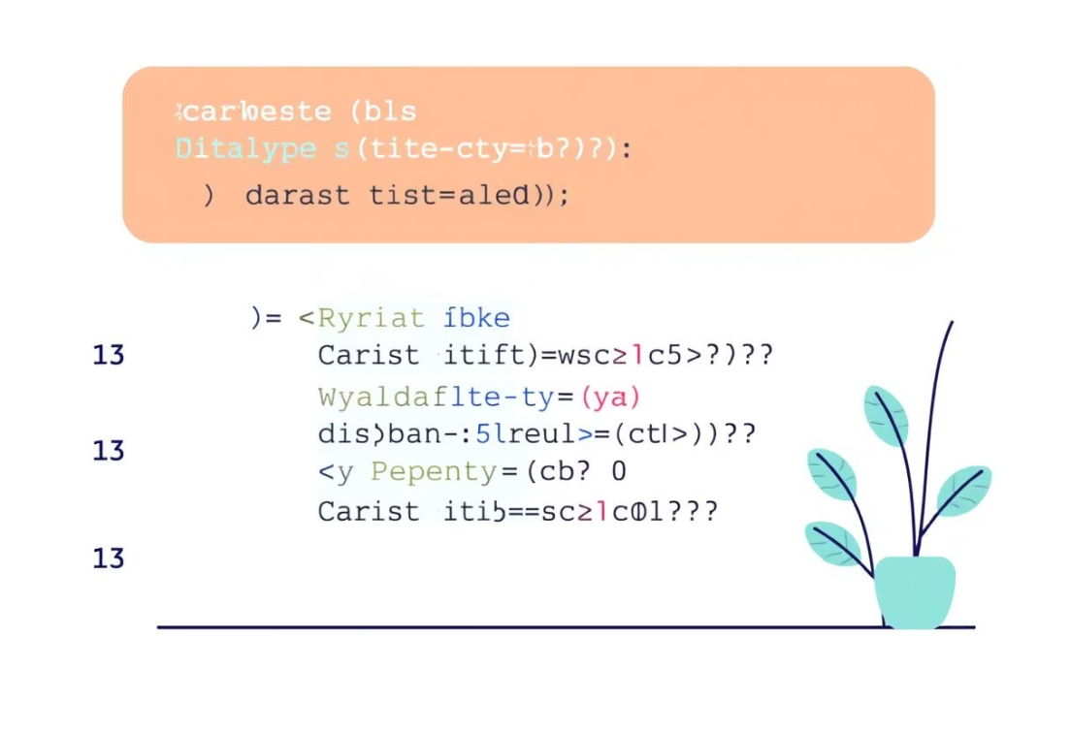
Exploratory Data Analysis with Databricks
Initial data exploration was conducted using Databricks to prepare and understand the dataset. This involved loading the data and ensuring data integrity through type conversions.
Data Loading
Data Integrity
The emissions dataset was imported into a new "emissions" catalogue within Databricks, creating a table for analysis.
Column data types were converted from string to double using Cast, Replace functions, or Regexp to ensure accurate calculations and analysis.

Slide 5
Data Analysis using SQL: Business Transactions
Structured analysis was performed in Databricks SQL Editor to answer key business questions regarding emissions. Queries were run within the "emissions" workspace.
01
02
Emissions by Location
Emissions vs. Population
Compared emissions in high-density versus low-density areas to understand geographic impact.
Analyzed emissions per person for each state, leveraging AI Assistant for SQL code generation.
03
04
Emissions vs. State
Highest Emissions by County
Identified the top 10 states with the highest emissions, including their percentage contribution to national emissions.
Ranked the top 10 counties with the highest emissions, highlighting areas for targeted intervention.

Slide 6

Emissions by Location: Density vs. Emissions
This analysis compared greenhouse gas emissions in highly dense areas against those in low-density regions. Understanding this relationship helps in identifying whether urban or rural settings contribute more significantly to overall emissions.
The visualization above illustrates the disparity in emissions based on population density, providing a foundational understanding for targeted environmental strategies.

Slide 7
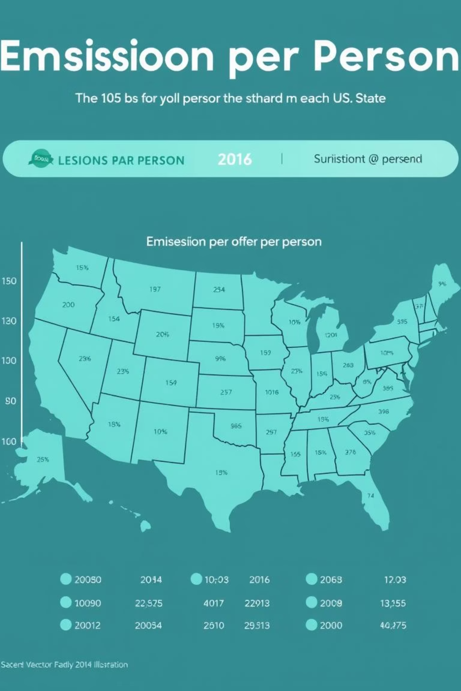
Emissions vs. Population: State-Level Analysis
We examined emissions per person for each state to normalize data and provide a clearer picture of individual impact. This metric helps in understanding the efficiency of emission control measures relative to population size.
Using AI Assistant, SQL queries were generated to facilitate this comparison, allowing for quick and accurate insights into state-level performance.

Slide 8
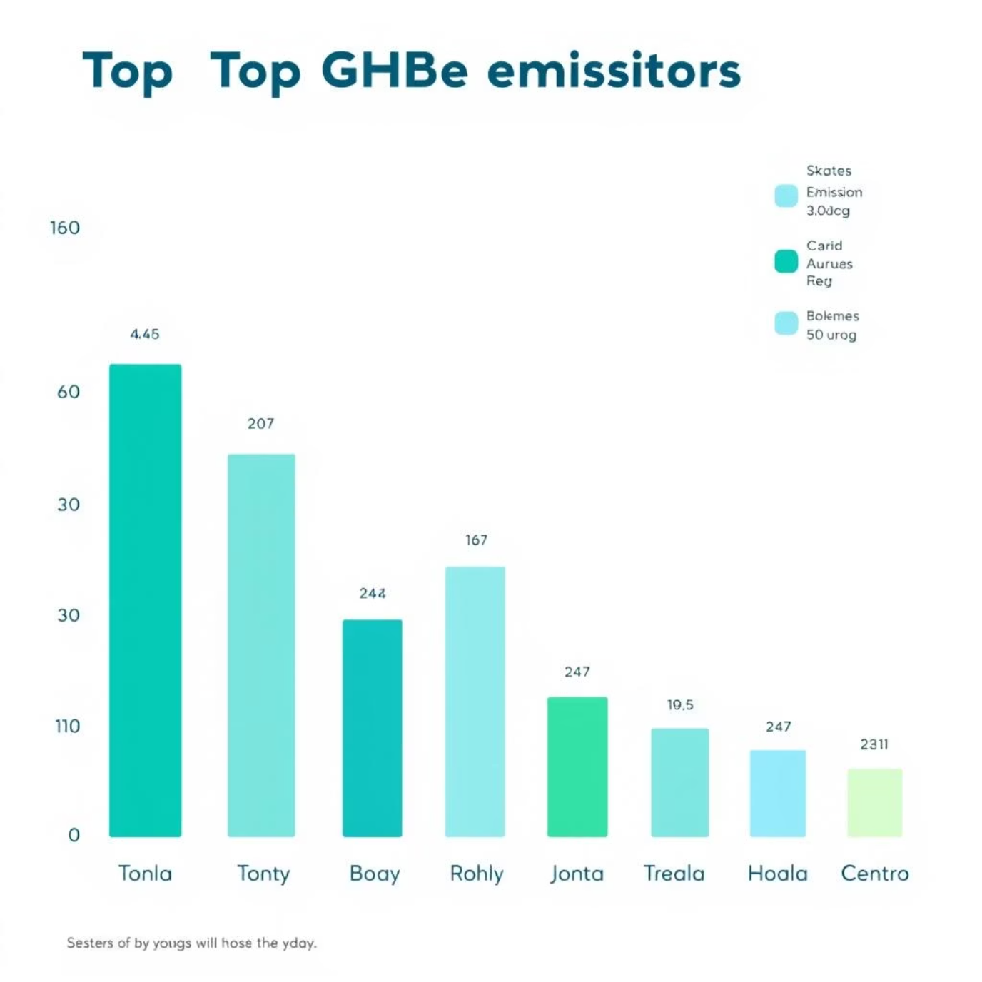
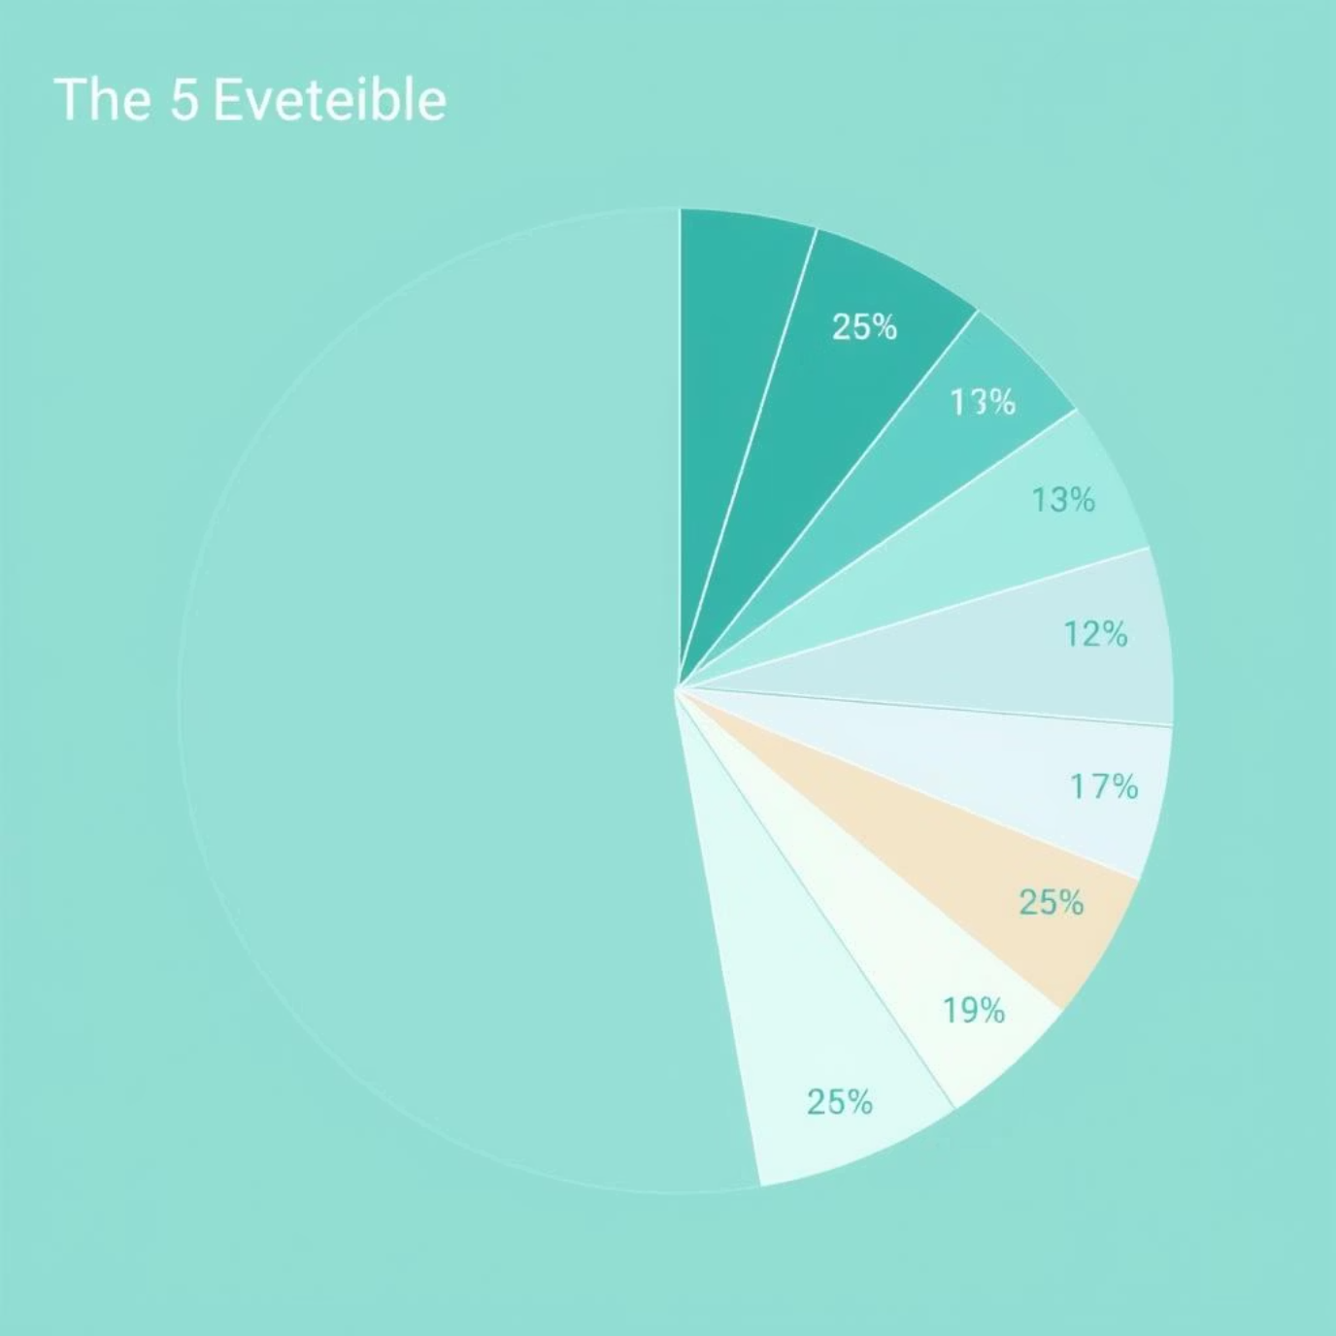
Top 10 States: Highest Emissions
Identifying the top 10 states with the highest overall emissions is crucial for prioritizing environmental efforts. This analysis also determined the percentage contribution of these states to the national total.
These insights are vital for policy-makers to focus resources and initiatives where they can have the most significant impact on reducing national emissions.

Slide 9
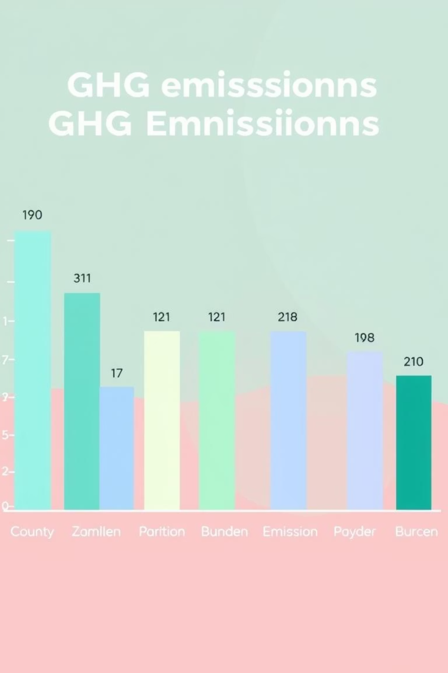
Highest Emissions by County: "County Shaming"
A detailed look into the top 10 counties with the highest emissions helps in pinpointing specific local areas that require immediate attention. This "county shaming" approach highlights localized environmental challenges.
This granular data allows for highly targeted interventions and community engagement programs to address specific emission sources within these counties.

Slide 10
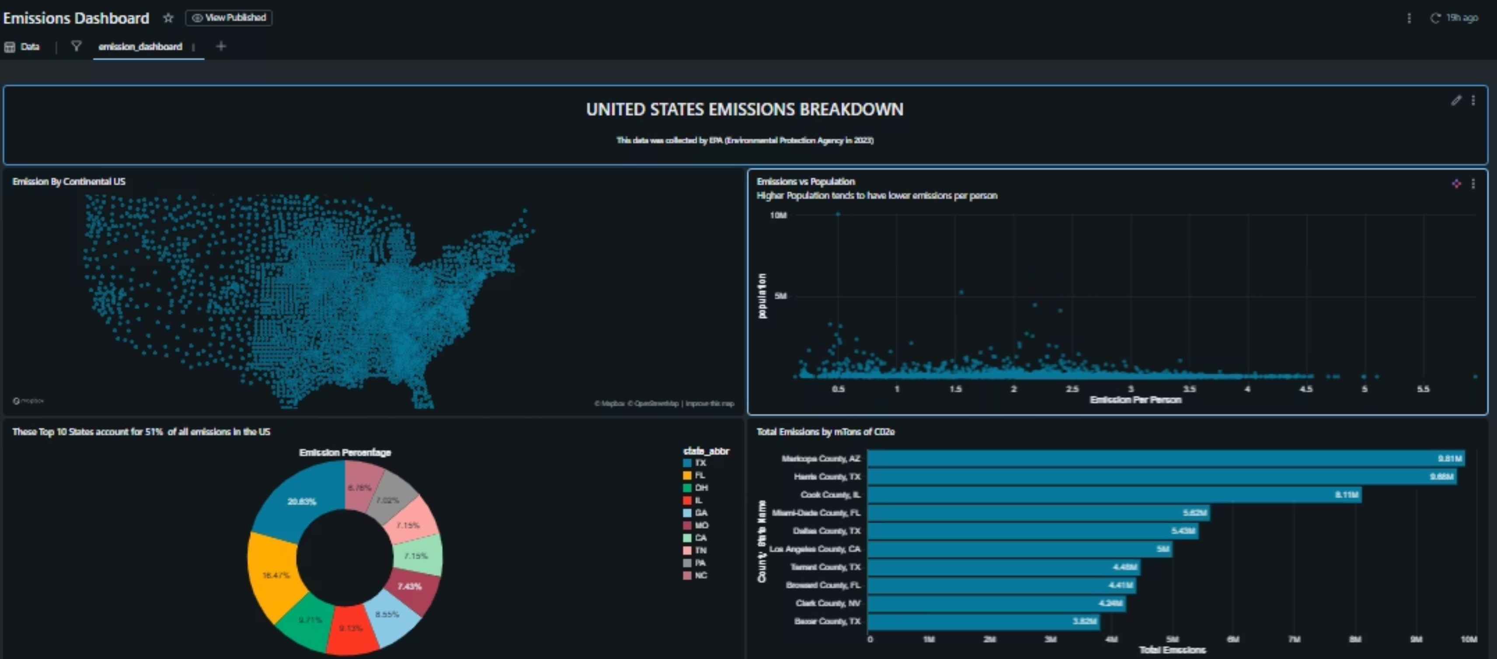
DASHBOARD IN DATABRICKS

Slide 11





Business Recommendations: Driving Emission Reduction
Target High-Emission Counties
Focus sustainability initiatives and investments where impact is maximized.
Monitor Emission Trends
Regularly analyze changes to assess policy effectiveness and adjust strategies.
Allocate Resources Efficiently
Direct funding to sectors or regions with the greatest reduction potential.
Engage Stakeholders
Share dashboard insights to foster collaboration and transparency.
Set Data-Driven Goals
Establish measurable reduction targets and track progress using dashboard metrics.

